Slide 1
Mastering STM32 Timers and PWM Configuration via STM32CubeMX
Overview
Embedded systems interact continuously with real-world devices such as sensors, motors, displays, communication modules, and actuators. Most of these operations require precise timing control. STM32 microcontrollers provide dedicated hardware modules called timers for this purpose. The operation of an STM32 timer is based on counting clock pulses. Every microcontroller operates using a clock signal.

Slide 2
INTRODUCTION
THE CORE CHALLENGE OF REAL-WORLD INTERACTION
THE EMBEDDED DILEMMA: EMBEDDED SYSTEMS MUST CONTINUOUSLY INTERACT WITH REAL-WORLD ELEMENTS LIKE SENSORS, MOTORS, AND ACTUATORS.
THE PRECISION REQUIREMENT: REAL-WORLD OPERATIONS DEMAND HIGHLY PRECISE TIMING INTERVALS.
  Example 1: Toggling a status LED precisely every 1.0 second.
  Example 2: Sampling a critical IoT temperature sensor precisely every 100 milliseconds.
THE SOLUTION: MICROCONTROLLERS RELY ON DEDICATED HARDWARE MECHANISMS TO MEASURE AND GENERATE DETERMINISTIC TIME INTERVALS WITHOUT WASTING PROCESSOR CYCLES.

Slide 3
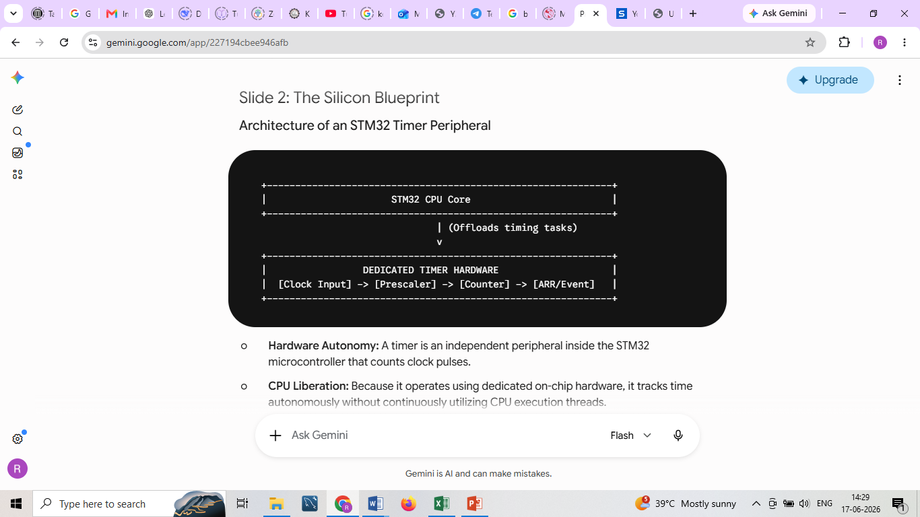
ARCHITECTURE OF AN STM32 TIMER PERIPHERAL
Hardware Autonomy: A timer is an independent peripheral inside the STM32 microcontroller that counts clock pulses.
CPU Liberation: Because it operates using dedicated on-chip hardware, it tracks time autonomously without continuously utilizing CPU execution threads.
The Clock Foundation: Every timing operation is directly derived from the microcontroller's master hardware clock signal.

Slide 4
THE ANATOMY OF A CYCLE
THE THREE-STEP TIMING PROCESS
RECEIVING CLOCK INPUT: THE TIMER RECEIVES A HIGH-FREQUENCY SIGNAL FROM THE STM32 CLOCK SYSTEM (E.G., A SYSTEM FREQUENCY OF 72 MHZ, PRODUCING 72 MILLION PULSES PER SECOND). THIS RAW SPEED IS GENERALLY TOO FAST FOR DIRECT TRACKING AND MUST BE ADAPTED.
COUNTING CLOCK PULSES: THE MODIFIED CLOCK TICKS AN INTERNAL COUNTER REGISTER (CNT). THE REGISTER CONTINUOUSLY INCREMENTS OR DECREMENTS.
GENERATING AN EVENT: WHEN THE COUNTER REACHES ITS PREDEFINED TARGET, THE HARDWARE FIRES AN EVENT.DOWNSTREAM TRIGGERS: THIS EVENT CAN AUTOMATICALLY TRIGGER AN INTERRUPT, ALTER A GPIO OUTPUT PIN, SIGNAL ANOTHER PERIPHERAL, OR OUTPUT A CONTINUOUS PWM WAVEFORM.

Slide 5
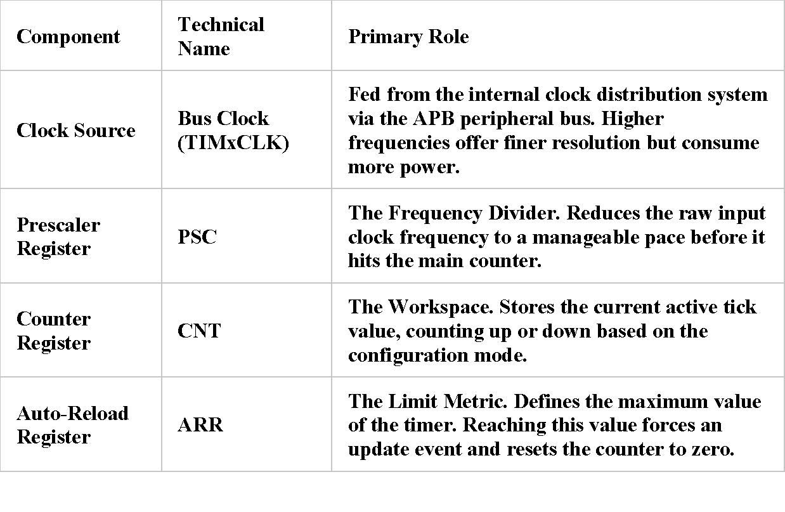
THE INTERNAL ARCHITECTURE
FOUR CORE TIMER COMPONENTS

Slide 6
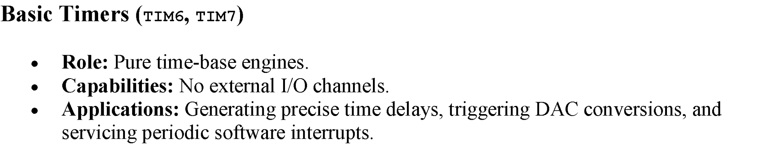
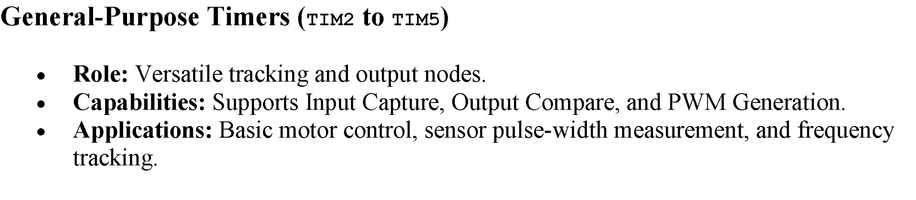
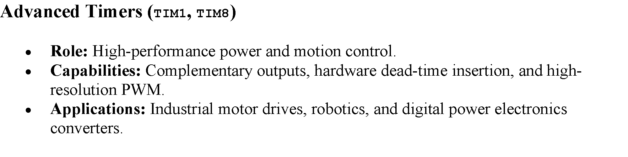
CLASSIFYING STM32 TIMER TYPES

Slide 7
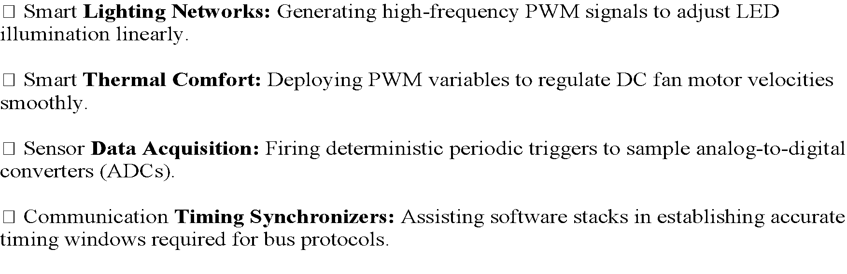
TIMERS AT THE EDGE OF IOT SYSTEMS

Slide 8
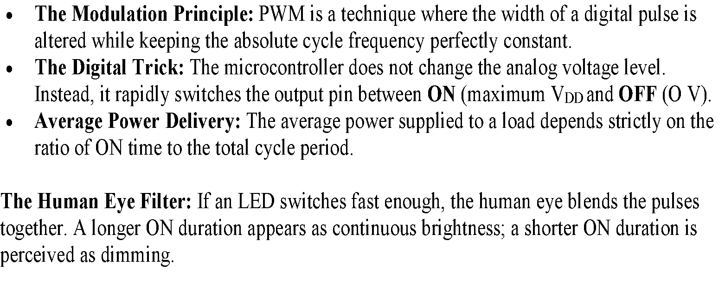
WHAT IS PULSE WIDTH MODULATION (PWM)?

Slide 9
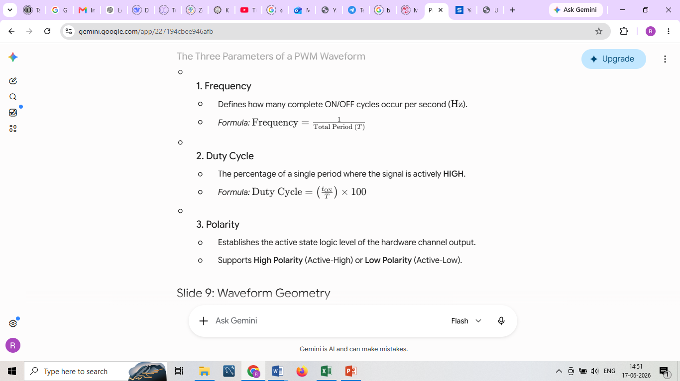
THE THREE PARAMETERS OF A PWM WAVEFORM

Slide 10
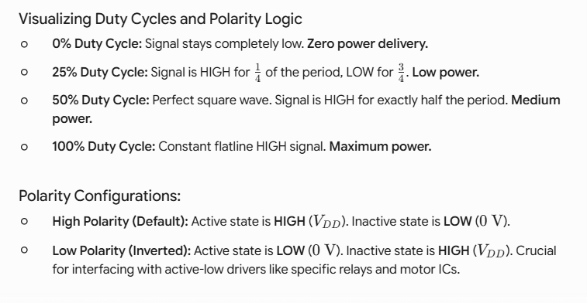
VISUALIZING DUTY CYCLES AND POLARITY LOGIC

Slide 11
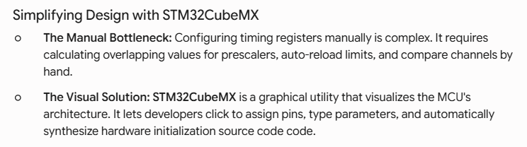
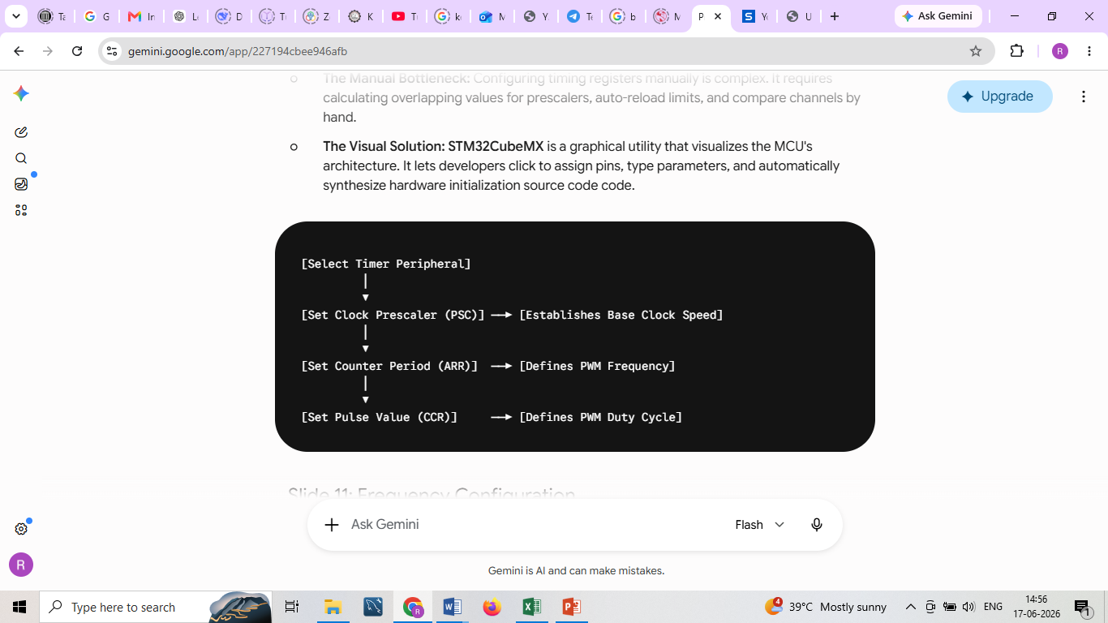
SIMPLIFYING DESIGN WITH STM32CUBEMX

Slide 12
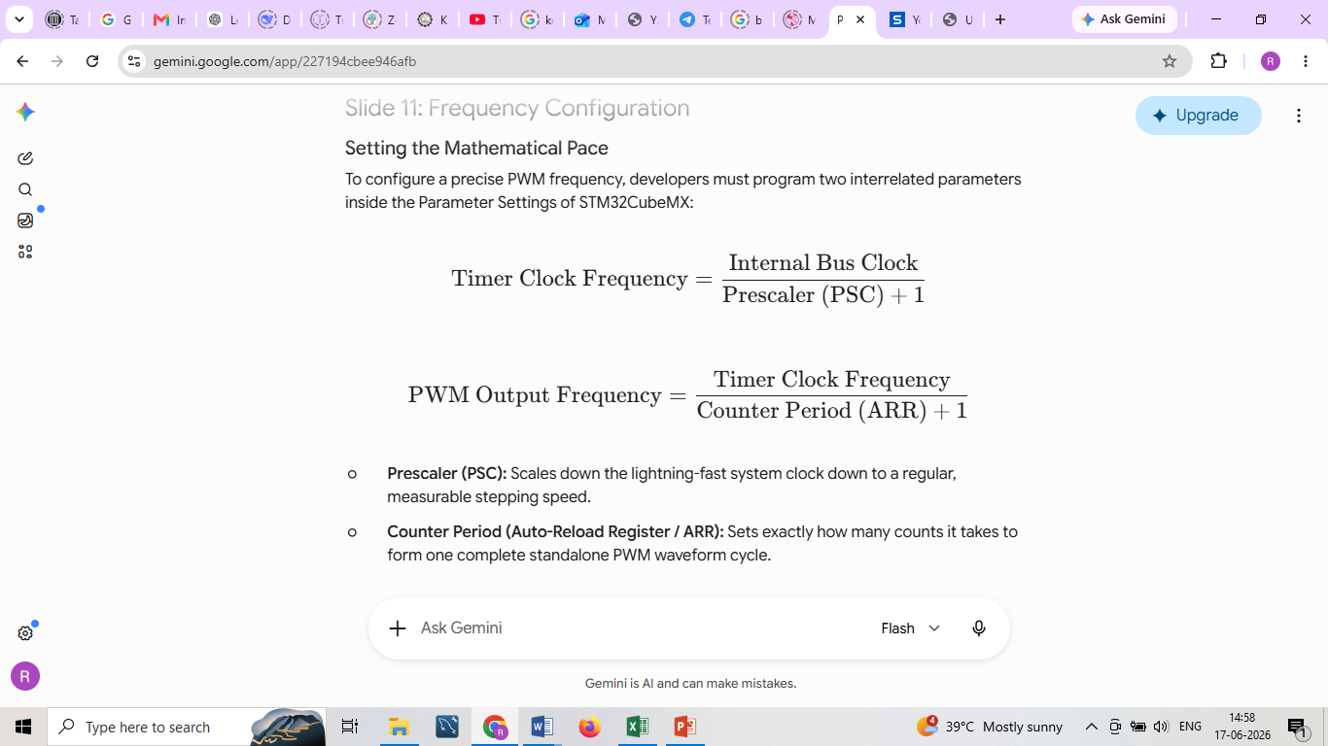
FREQUENCY CONFIGURATION

Slide 13
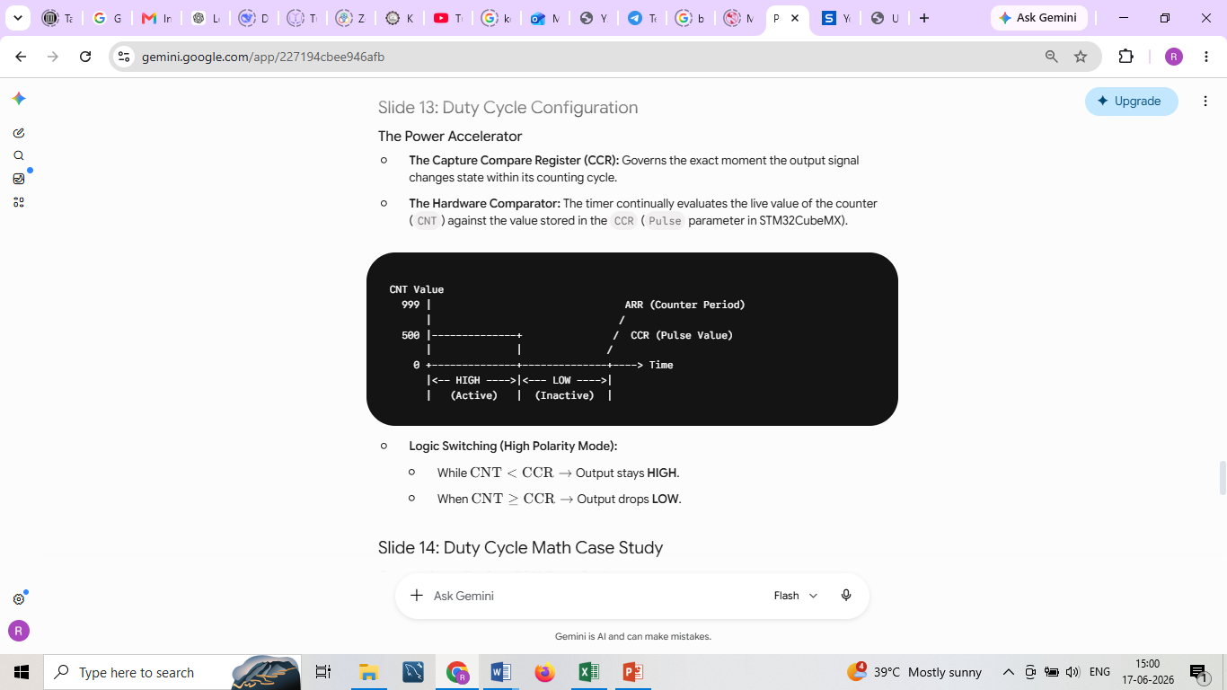
DUTY CYCLE CONFIGURATION

Slide 14
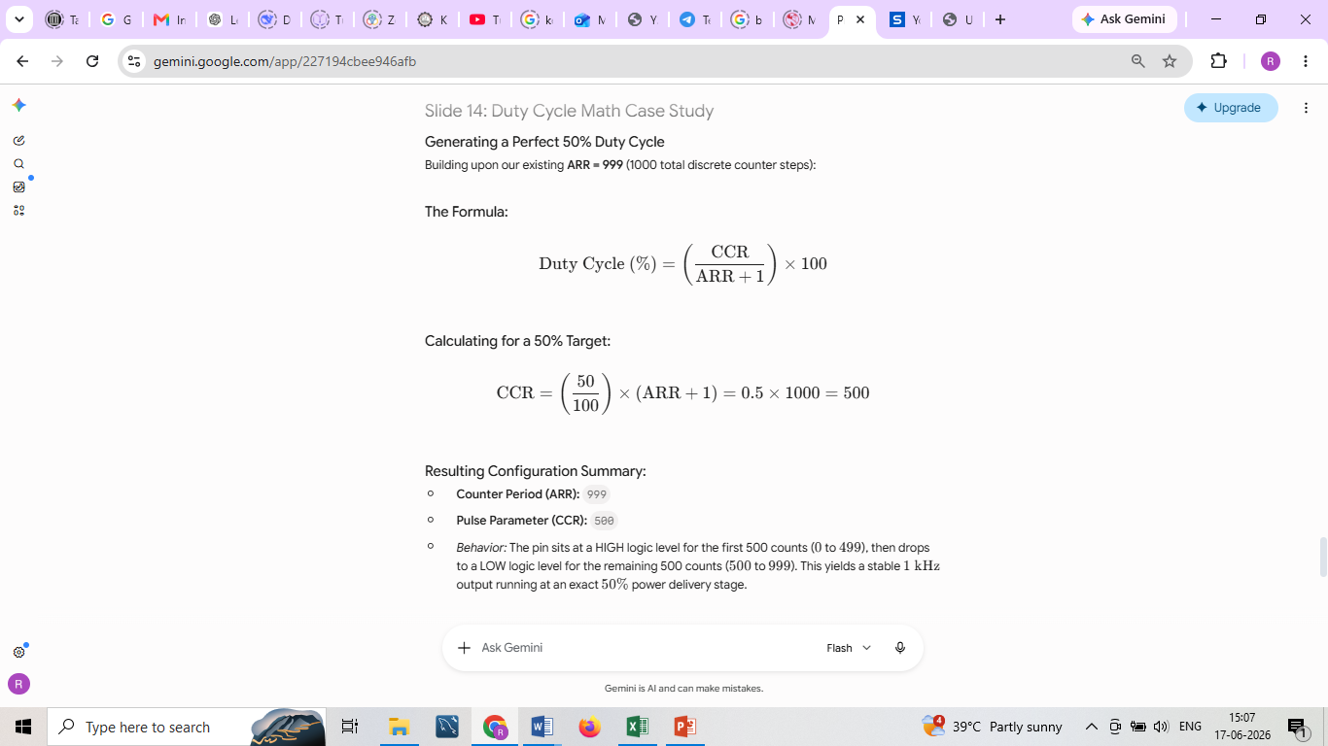
DUTY CYCLE MATH CASE STUDY

Slide 15
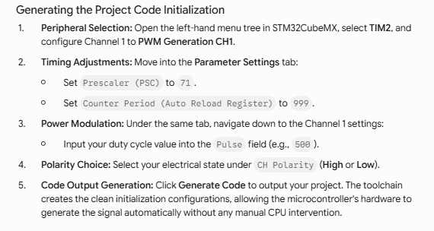
STEP-BY-STEP CUBEMX WORKFLOW

Slide 16
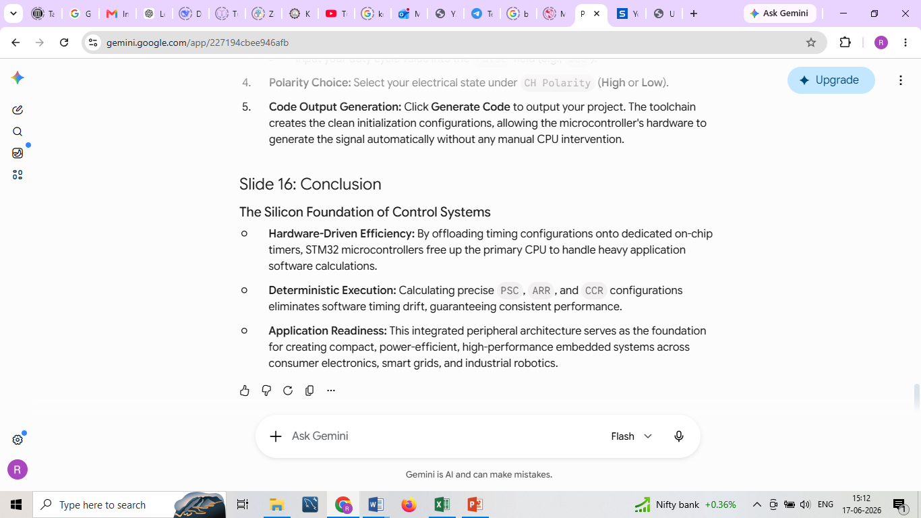
Conclusion

